Slide 1
10
's multiplication

Slide 2
Review: write down the multiplication sentence
5 (threes)
4 (sixes)
7 (eights)
9 (twos)
1 (five)
5×3
4×6
7×8
9×2
1×5

Slide 3
Review: write down the multiplication sentence
8+8+8+8
6+6+6
4+4+4+4+4
3+3+3+3+3+3
7+7+7+7+7+7+7+7
4×8
3×6
5×4
6×3
8×7

Slide 4
Number line
10
10

Slide 5
Jump on the number line
Jump for 10 scales each time

Slide 6
Jump on the number line
0
10
20
30
40
50
60
70
80
90
100
0（ten）
2（tens）
4（tens）
6（tens）
10（tens）
8（tens）
1（ten）
3（tens）
5（tens）
7（tens）
9（tens）
Jump for time（s），jumped to___， （tens）
five
20
2
50
seven
90
three
zero
four
eight
ten
one
six
10
60
70
80
nine
0
1
two
5
40
9
100
30
10
3
0
4
6
7
8
1×10=10
3×10=30
4×10=40
6×10=60
7×10=70
10×10=100
2×10=20
5×10=50
9×10=90
0×10=0
8×10=80

Slide 7
10
's multiplication

Slide 8
10's mutiplication
0×10=0
1×10=10
2×10=20
3×10=30
4×10=40
5×10=50
6×10=60
7×10=70
8×10=80
9×10=90
10×10=100

Slide 9
When a number is multiplied by 10,
the product is to put a 0 at the end of this number.

Slide 10
Fill in the blanks
40=（ ）×10
4
5
50=10 ×（ ）
10=（ ）× 10
1
（ ） × 10=90
9
0=（ ）× 10
0
20=10 ×（ ）
2
10 × （ ）=100
10

Slide 11
calculate
0
0
2
0
20
10
100
5
50
10×
1
=
10
8
×10=
80
9
90
0
0
4
40
6
60

Slide 12
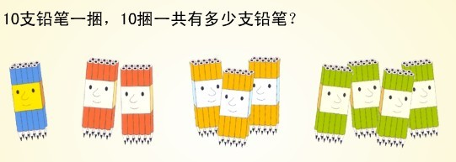
Ten pencils a bundle ,how many pencils are there in ten bundles?
×
=
10
10
100

Slide 13
The workman wants to tile 5 rows, every row has 10 tiles, how many tiles will he need all together ？
number sentence：_______________
5×10=50

Slide 14
How many pencils?
Can you use the multiplication sentence?
4 (tens)
7
4×10
＋ 7
= 47
40
+ 7
= 47

Slide 15
How many pencils?
Can you use the multiplication sentence?
borrow 3 pencils，makes 10
5（tens）
5×10
－3
= 47
50
－ 3
= 47

Slide 16
In a number sentence with a multiplication and an addition
or with a multiplication and a subtraction,
you should do the multiplication first
and then the addition or subtraction.

Slide 17
Calculate
0
0×10=
10×3=
40= ×10
50=10×
30
4
5

Slide 18
Challenge
87
(1) 8×10+7= (2)9×10-8=
+7= -8=
7×10+4= 10×6-7=
+4= -7=
82
80
87
90
82
74
53
70
74
60
53

Slide 19
What did we learn today?

